Slide 1
Coding Fillable Form in Bootstrap
By Grace Miller and Oyinlola Kayode

Slide 2
Discussion:

Slide 3
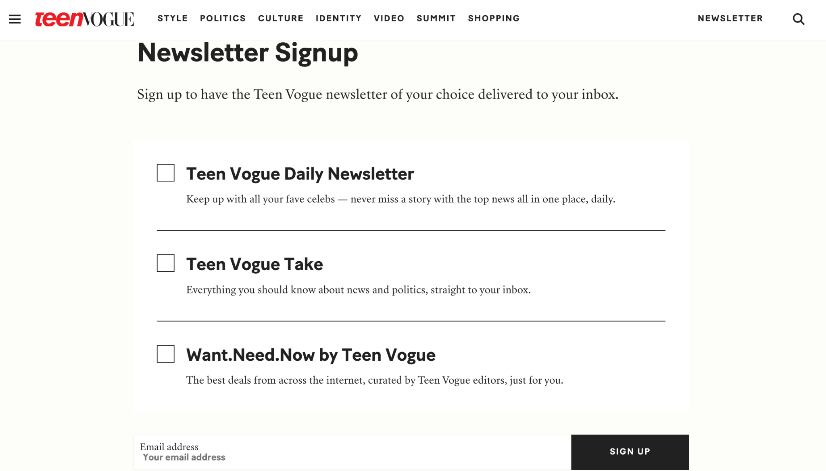
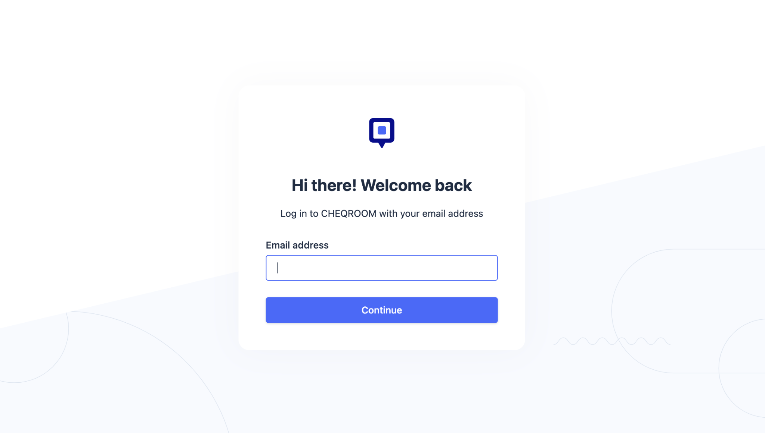
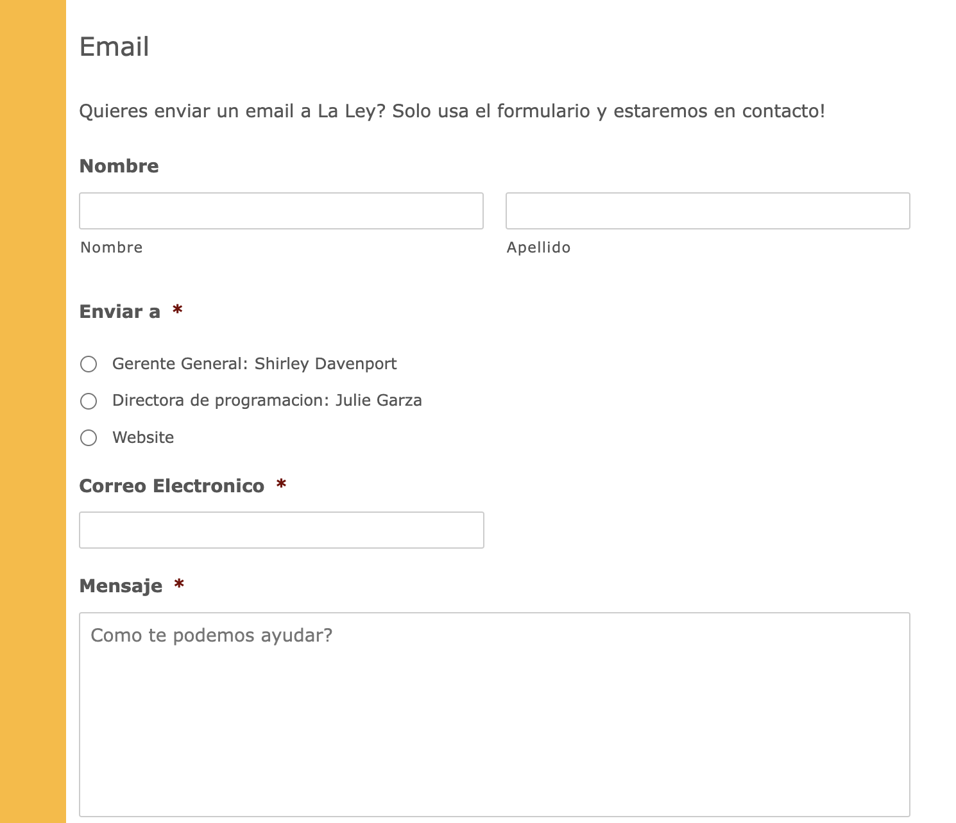
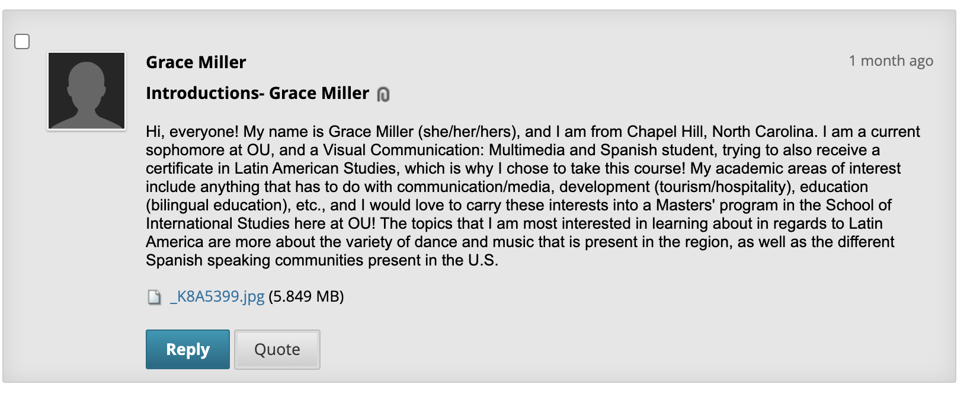
Use Cases:
Data collection
Surveys
Login-screens
Registration forms
Contact forms- questions, comments, etc.
Discussion forums- e.g. Blackboard

Slide 4
Best Practices: As learned from Mono
https://mono.company/design-practice/the-10-commandments-of-good-form-design-on-the-web/
Legible/strong labels with corresponding font size and length of text
No frustration in selecting each field
Plain checks/radio buttons
Options vs. required (much like OU’s forms)
Bare minimum
Etc.

Slide 5
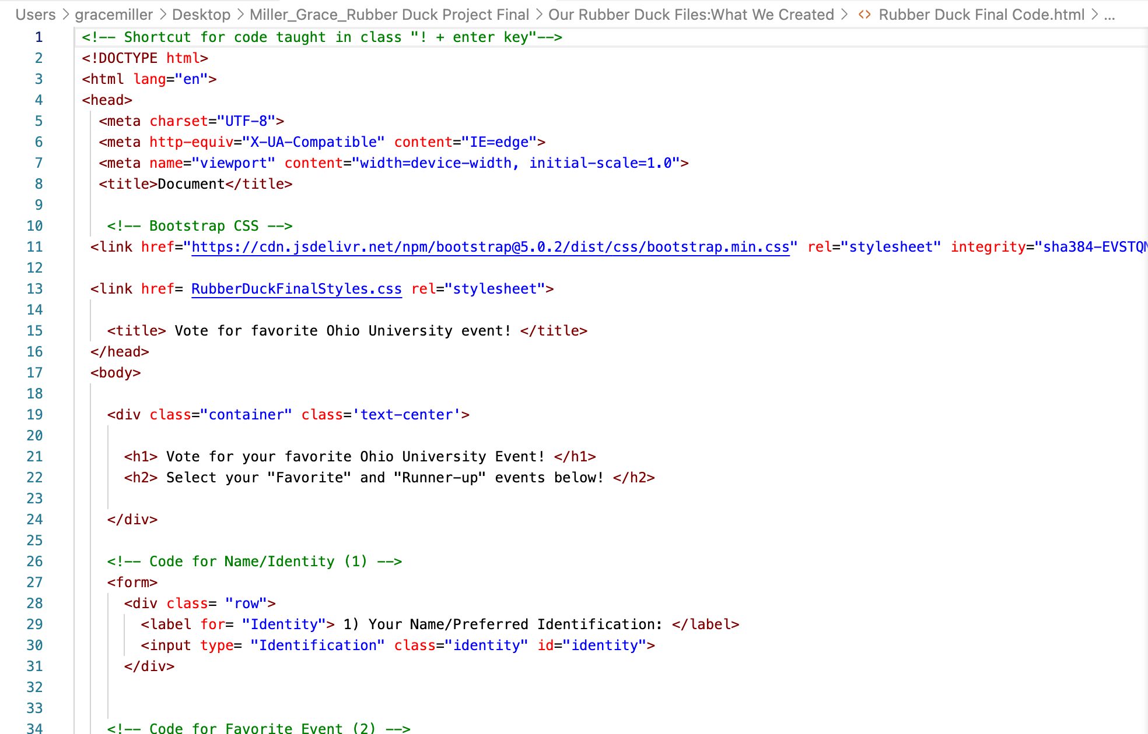
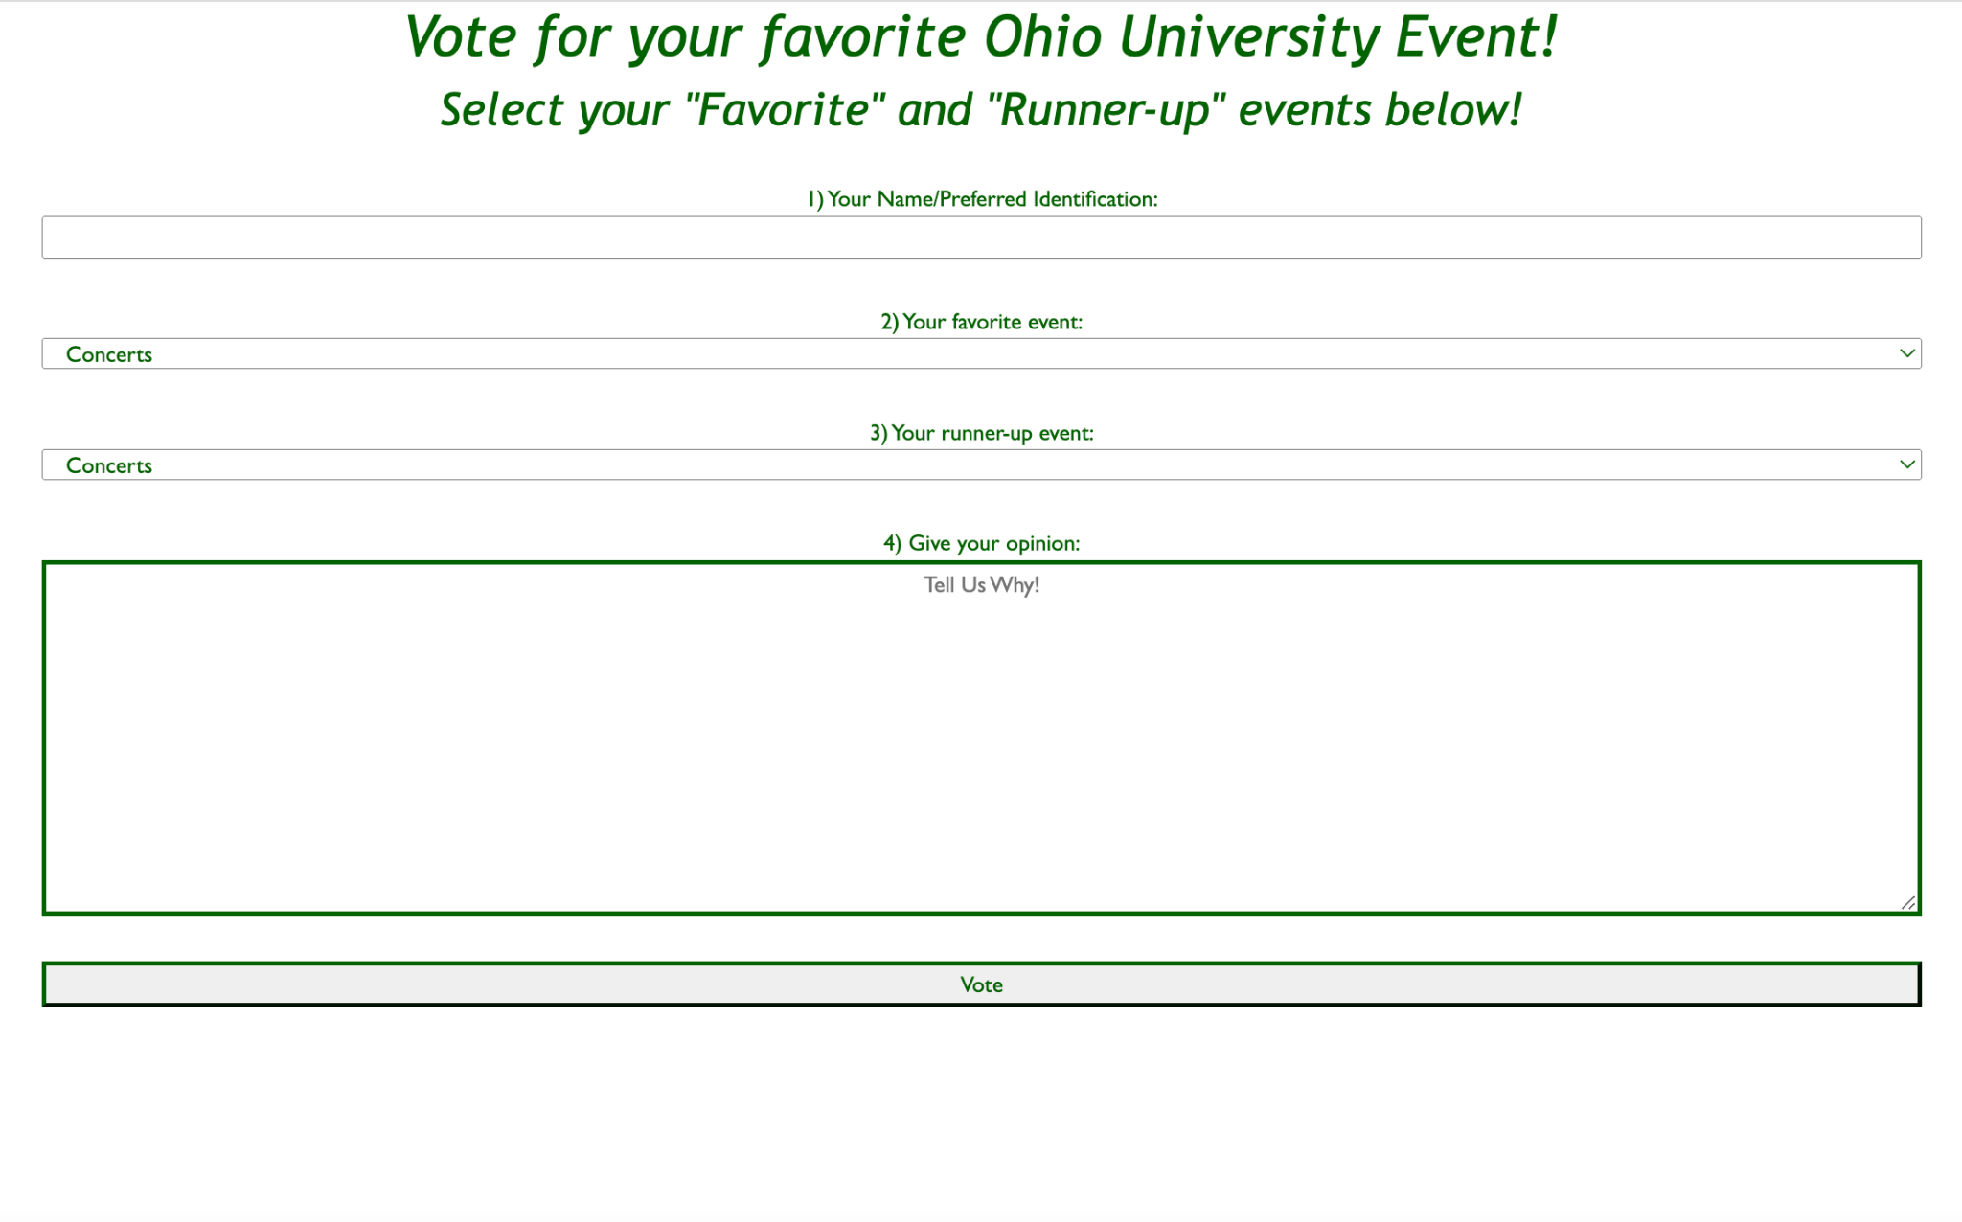
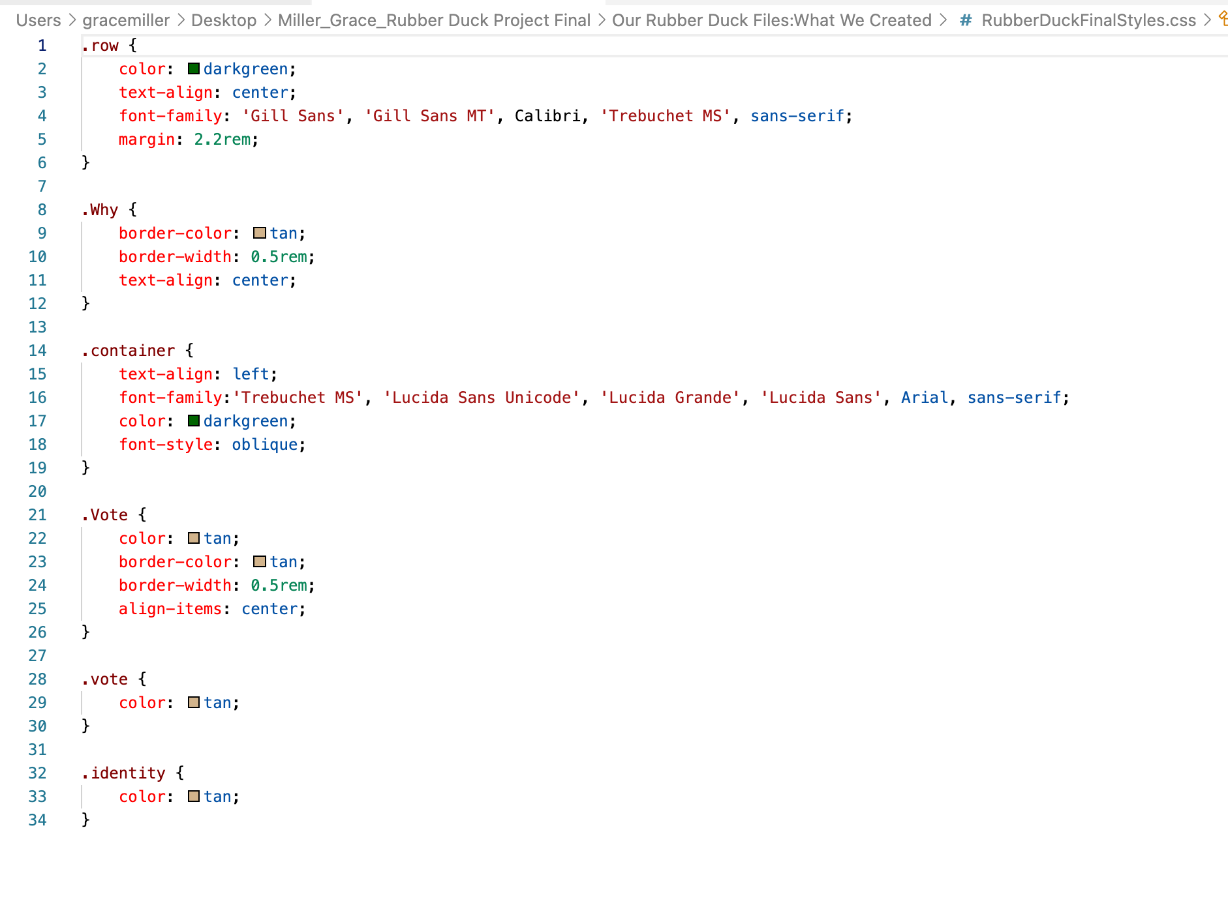
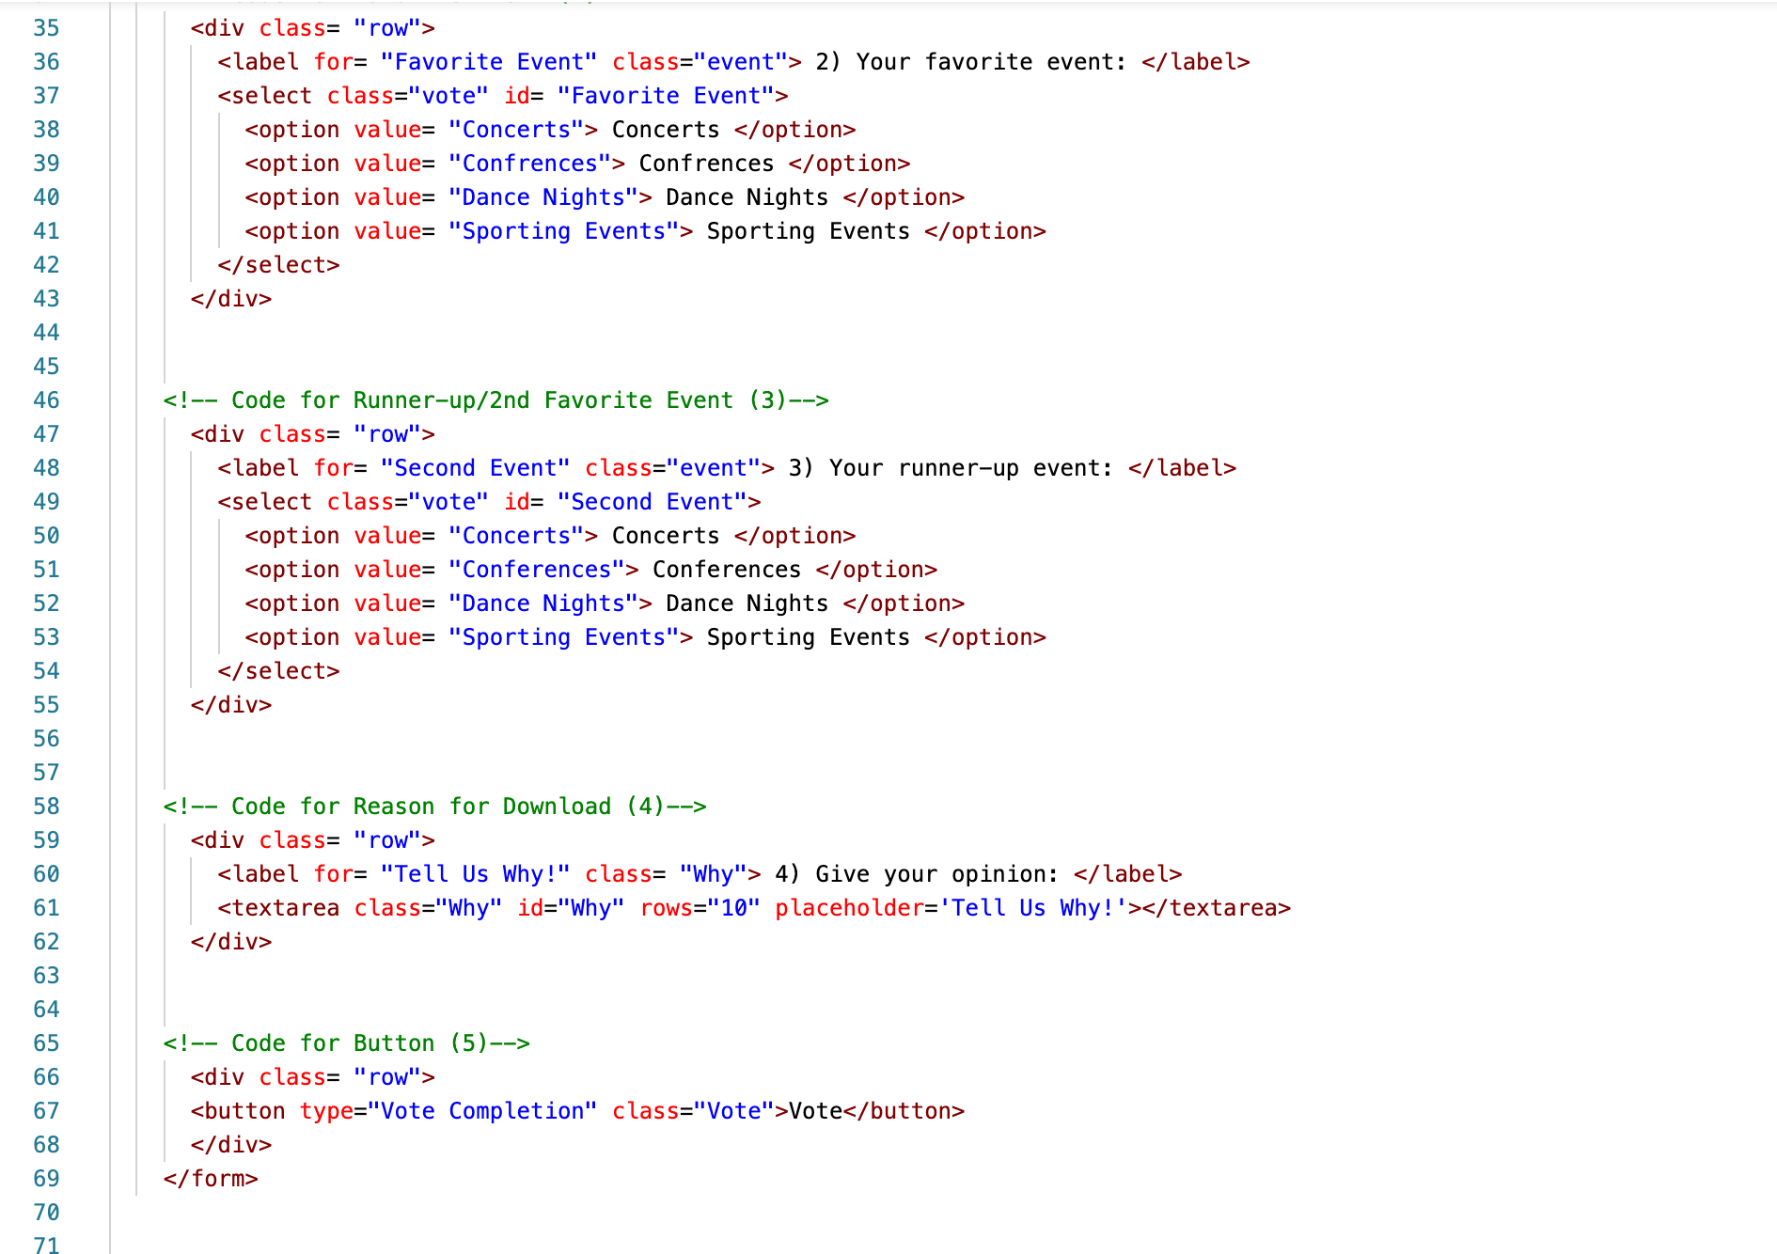
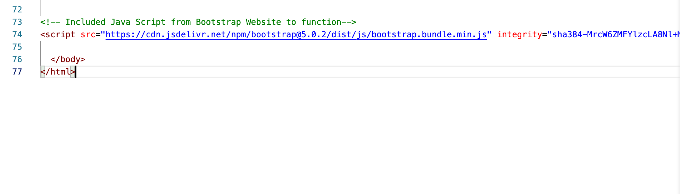
Our Example/Creation:

Slide 6
Essential Elements:
To be discussed in presentation:
<label>
<input>
<select>
<option>
<textarea>
<button>
Etc.

Slide 7
In-Class Follow Along
(Step-by-Step for Beginner):

Slide 8
Project: Submit a Valentine!

Slide 9
HTML:

Slide 10
Preface Steps: * Don’t forget to save work + comment!
Open a new HTML document, set it up with shortcut learned in class: “! + enter key”.
Save work with a name, such as “FillableForm_BootstrapPractice”.
Make a <!--comment --> for “Bootstrap CSS” and link your CSS Style Sheet, for example:
<link href= BootstrapFillableForm.css rel= “stylesheet”>
Add your <title> tags with a title such as <title> Send a Valentine. </title>
Next, add your <div class= “container”> to following the nesting procedures.
Working below your opening <body> and </header> tag from the HTML shortcut, create your <h1> and </h1> tags with a header of your choosing such as “Send a Valentine”. Close your previous </div>.
Go down to your closing </body> tag and insert your JavaScript (also found on Bootrstrap’s “Introduction” page by:
<script src="https://cdn.jsdelivr.net/npm/bootstrap@5.0.2/dist/js/bootstrap.bundle.min.js" integrity="sha384-MrcW6ZMFYlzcLA8Nl+NtUVF0sA7MsXsP1UyJoMp4YLEuNSfAP+JcXn/tWtIaxVXM" crossorigin="anonymous"> </script>
Now it is time to create your form!

Slide 11
Step 1: To & From (“Labels/x2”)
Make a <!--comment --> for “To Field”, and open your <form> tag.
Add your <div class= “row> and <div class= “column”> tags to keep your nesting.
Add your first <label> tag, which includes what the label is for, the class of the label/what it is/type, as well as the text of the label (content) before closing it.
<label for= “To” class= “to”> To: </label>
Next, you want to describe what will be “inputted” into that section of the form, which will be the content of who will be receiving the valentine written in text. To do this, open an <input> tag with:
<input type= “text” class= “text” id= “text”>
Close your two <div> tags for column and row.
Make a <!--comment --> for “From Field”, and copy and paste Steps 2-5 to create the “From Field”, making sure to go back to rewrite your content to match the new label before proceeding.

Slide 12
Step 1 Coded: (sans Preface steps)
<!-- Code for To (1) →
<form>
<div class= "row">
<div class= "column">
<label for= "To” class= “to”> To: </label>
<input type= "text" class="text" id=”text">
</div>
</div>
<!-- Code for From (2) -->
<form>
<div class= "row">
<div class= "column">
<label for= "From” class= “from”> From:: </label>
<input type= "text" class="text" id=”text">
</div>
</div>
Don’t forget proper indentation!

Slide 13
Step 2: Selecting a Gift (“Select”/Drop-down”)
Make a <!--comment --> for “Selecting a Gift”, and open a new <label> tag.
Add your <div class= “row”> for nesting.
The <label> tag can be copied and pasted from Step 1, just make sure to change the content to something like what is down below.
<label for= “Selecting a Gift” class= “gift”> Select a Gift: </label>
Next, you want to open a <select> tag, giving it a class, and an id.
<select class= “gift” id= “gift”>
Below this code, you will be adding <option> tags with values, that will describe the selection of gifts, which will be discussed on the next slide.

Slide 14
Step 2: Selecting a Gift (Cont.)
5. Decide how many gifts you want available for selection. Each gift will consist of a <option> tag and value with text.
If you want to have the option of three available gifts, a plush, flowers, and candy. Your code will have three <option> tags with their corresponding values like this:
<option value= “plush”> Plush </option>
<option value= “flowers”> Flowers </option>
<option value= “candy”> Candy </option>
Of course, this is another section of the project where you can copy and paste, once you have the code for your original <option>.
6. Lastly, do not forget to close out your code with </select> element, since this will be our only selection option in our form, followed by the your </div> tag.

Slide 15
Step 2 Coded:
<!-- Code for Selecting a Gift (3) -->
<div class= "row">
<label for= "Selecting a Gift" class="gift"> Select a Gift: </label>
<select class="gift" id= "gift">
<option value= "plush"> Plush </option>
<option value= "flowers"> Flowers</option>
<option value= "candy"> Candy </option>
</select>
</div>
Don’t forget proper indentation!

Slide 16
Step 3: Message (“Text Area”)
Make a <!--comment --> for “Creating Message”, and open a new <label> tag.
Add your <div class= “row”> for nesting.
Once again, the <label> tag can be copied and pasted from Step 1, just make sure to change the content.
<label for= “Message” class= “message”> Message: </label>
Next, you are going to open the <textarea> tag , which creates an element that is the equivalent to what we know as a “text box”. The <textarea> tag will include a “name” and “id”, “rows” with a value, and text before being closed.
<textarea class="day message" id="message” rows="15"> Valentine’s Day Message</textarea>
Close your <div> tag.

Slide 17
Step 3 Coded:
<!—-Creating Message (4)-->
<div class= "row">
<label for= "Message" class= "message"> Message: </label>
</div>
<div class= "row">
<textarea class="day message" id="message” rows="15"> Valentine’s Day Message</textarea>
</div>
Don’t forget proper indentation!

Slide 18
Step 4: Submit (“Button”)
You’ve made it to the end! The last thing to code is the button and to check and make sure all your elements are closed!
Make a <!--comment --> for “Submit Button”, and open a <button> element.
Add your <div class= “row”> for nesting.
Within the <button> element, you will have a “type”, “class”, and of course, your text.
<button type= “Submit” class= “submit”> Submit </button>
You will want to make sure all of your coded elements are closed, which should end with a closed </div>, </form>, </body>, and of course, your </html>.
Save, refresh, and check the new fillable form you created in your browser! Congratulations!

Slide 19
Step 4 Coded:
<!-- Code for Button (5)-->
<div class= "row">
<button type="Submit" class="submit">Submit</button>
</div>
</form>
Don’t forget proper indentation!

Slide 20
Now, let’s add some quick CSS for style:

Slide 21
Quick CSS additions (our perspective):
.container {
color: pink;
text-align: center;
}
.row {
color: red;
text-align: center;
font-family:'Segoe UI', Tahoma, Geneva, Verdana, sans-serif;
}
.gift {
color: lightcoral;
}
.message {
color: lightcoral;
}
.from {
color: lightcoral;
}
.to {
color: lightcoral;
}
.submit {
color: pink;
border-width: 0.5rem;
border-color: pink;
}

Slide 22
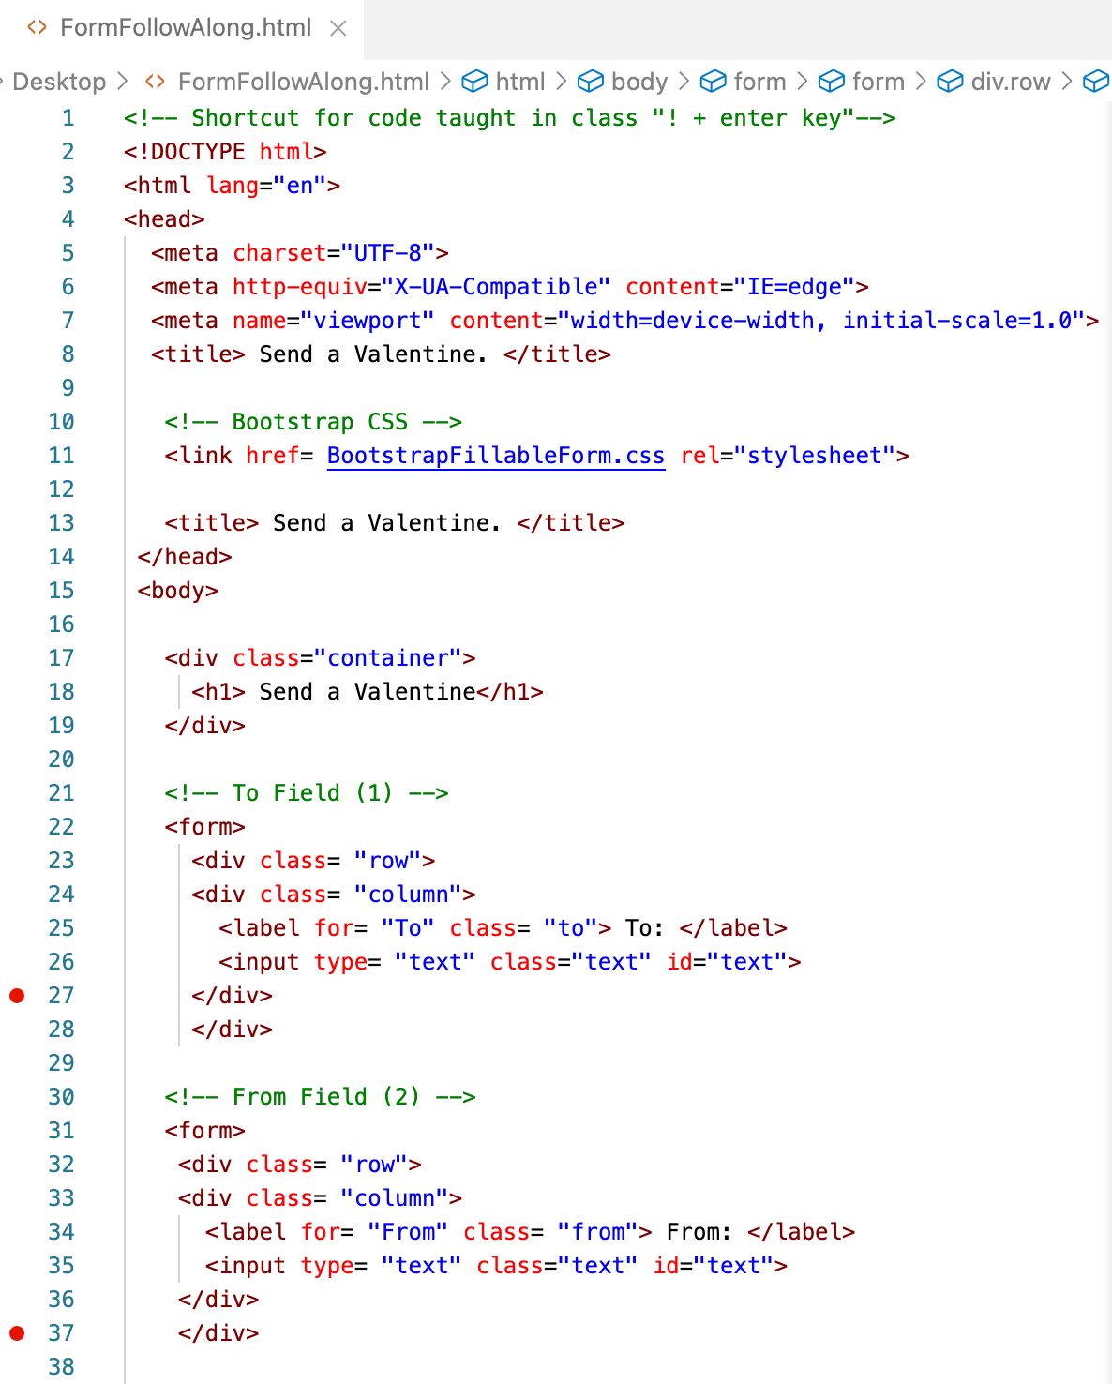
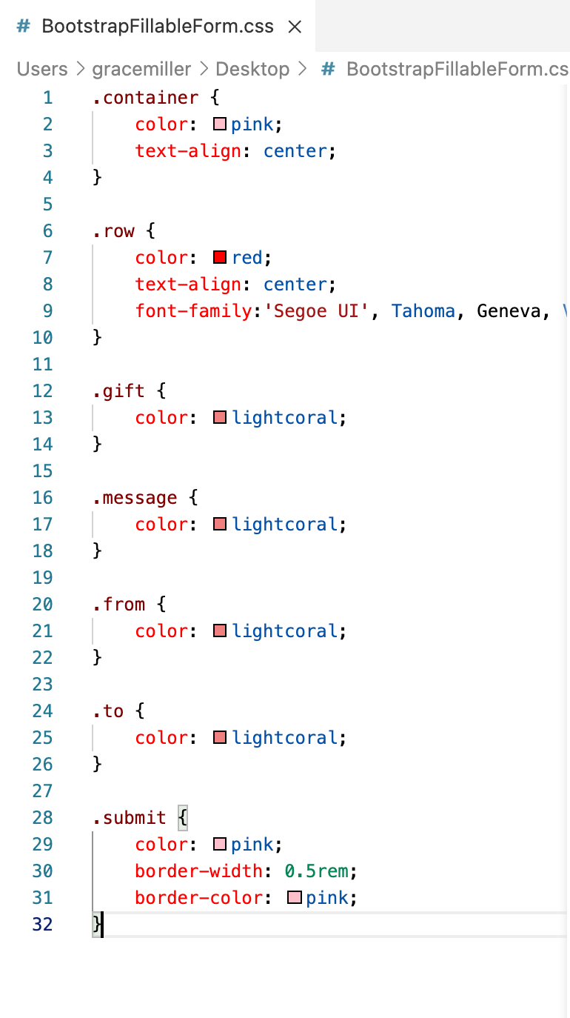
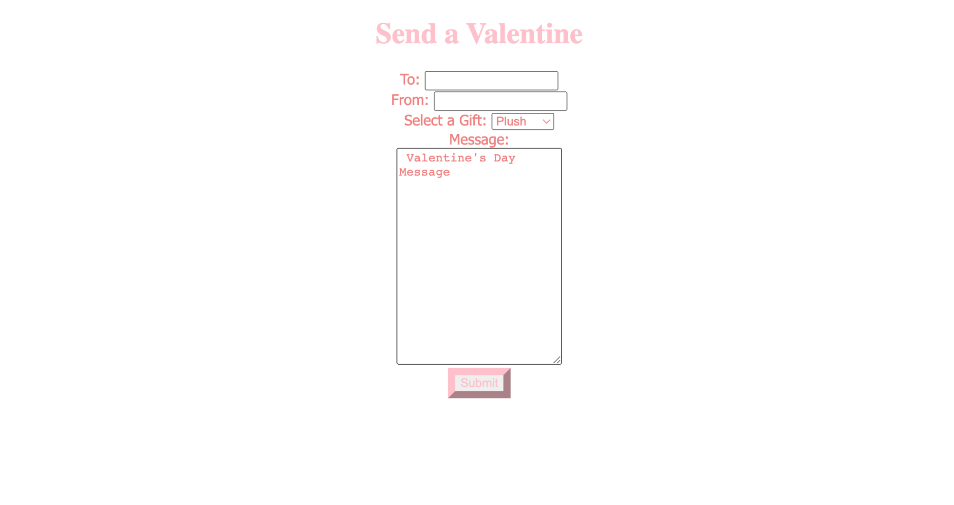
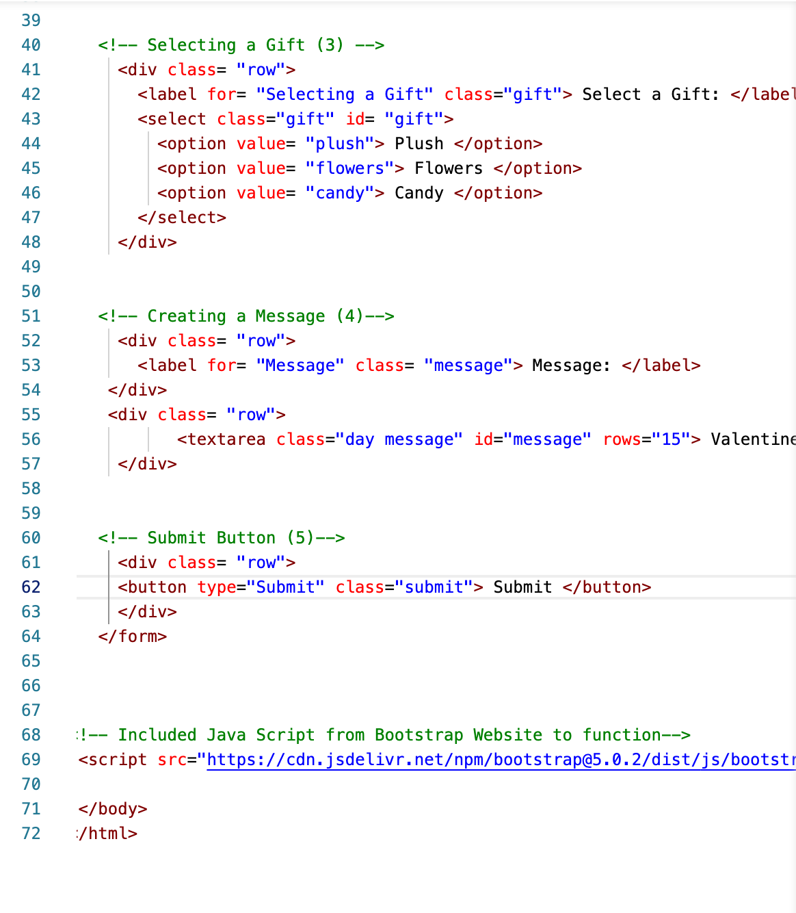
End Product:

Slide 23
Troubleshooting.
Our biggest problem: Nesting.

Slide 24
Viewing of our Cheatsheet Website:

Slide 25
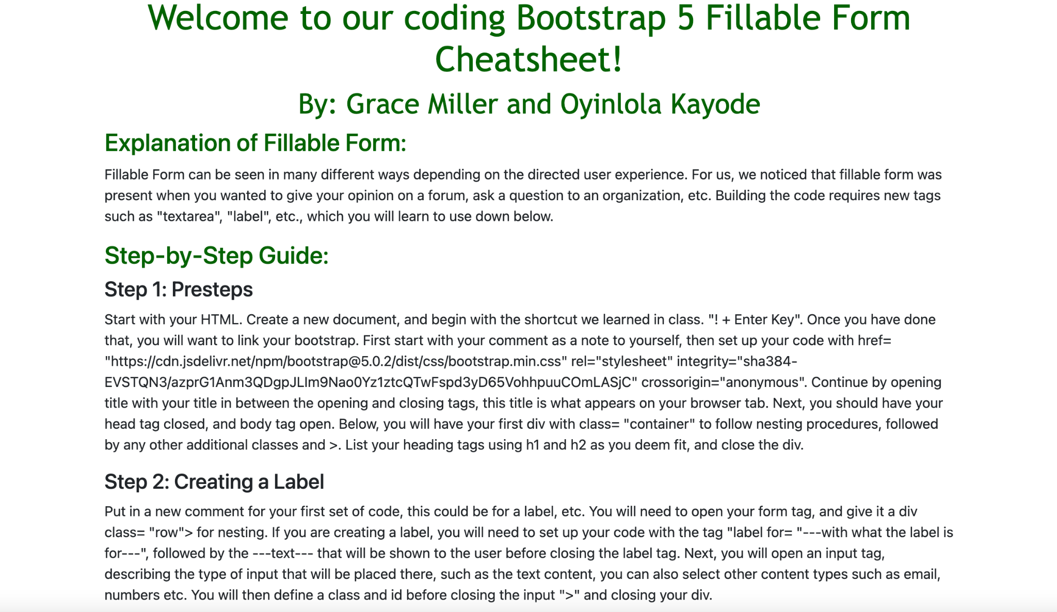
Screenshot of Cheatsheet Website:
Includes step-by-step guide. (HTML, CSS, Web Look), see entirety on Github

Slide 26
Cheatsheet Websites can also be found on each creators’ personal Github.

Slide 27
Citations for all documents:
“Bootstrap 5 Forms." W3 Schools, W3 Schools, 2022, www.w3schools.com/bootstrap5/bootstrap_forms.php.
"Floating labels ." Bootstrap v5.0, Bootstrap, getbootstrap.com/docs/5.0/forms/floating-labels/. Accessed 14 Feb. 2022.
"Form controls." Bootstrap v5.0, Bootstrap, getbootstrap.com/docs/5.0/forms/form-control/. Accessed 14 Feb. 2022.
"Forms." Bootstrap v5.0, Bootstrap, getbootstrap.com/docs/5.0/forms/overview/. Accessed 14 Feb. 2022.
Frankly Media. "Contactanos." La Ley 101.1 FM, WYMY-FM, 2021, www.laleync.com/contactanos/.
"Grid system." Bootstrap v5.0, Bootstrap, getbootstrap.com/docs/5.0/layout/grid/. Accessed 14 Feb. 2022.
"Introduction." Bootstrap v5.0, Bootstrap, getbootstrap.com/docs/4.3/getting-started/introduction/. Accessed 14 Feb. 2022.
"Login." CHEQROOM, CHEQROOM, login.cheqroom.com/. Accessed 14 Feb. 2022.
Mazzocca, Nicki. “Bootstrap Basics.” PPT, 8 Feb. 2022, https://catmailohio-my.sharepoint.com/:p:/r/personal/mazzocca_ohio_edu/_layouts/15/Doc.aspx?sourcedoc=%7B90F204F5-0914-470A-BFA8-2B9A540D6E37%7D&file=Bootstrap.pptx&action=edit&mobileredirect=true&cid=f5796163-0532-4a93-a4ec-f03ad9583b8c .
Mazzocca, Nicki. “CSS Review.” PPT, 22 Jan. 2022, https://catmailohio-my.sharepoint.com/:p:/r/personal/mazzocca_ohio_edu/_layouts/15/Doc.aspx?sourcedoc=%7BD6879EDC-DA80-44C4-98AC-095B49F05A67%7D&file=Interactive%20II%20-%20CSS%20Review.pptx&action=edit&mobileredirect=true&cid=2618402f-7338-4bed-8fc4-6623fdb27161
Mazzocca, Nicki. “CSS Visual Rules.” PPT, 23 Jan. 2022, https://catmailohio-my.sharepoint.com/:p:/r/personal/mazzocca_ohio_edu/_layouts/15/Doc.aspx?sourcedoc=%7BB381ABBE-A5C2-4217-A076-1334FDC025D4%7D&file=CSS_%20%20Visual%20Rules.pptx&action=edit&mobileredirect=true&cid=5f44a010-ad12-4aa4-b6a4-9bbc0ea7dd34

Slide 28
Citations for all documents: (cont.)
Mazzocca, Nicki. “HTML Review1.” PPT, 30 Jan. 2022,
https://catmailohio-my.sharepoint.com/:p:/r/personal/mazzocca_ohio_edu/_layouts/15/Doc.aspx?sourcedoc=%7B395DF430-7B58-4CC8-B949-34278CDED8B6%7D&file=Interactive%20II%20-%20HTML%20Review1.pptx&action=edit&mob
ileredirect=true.
Miller, Grace. "Thread: Introductions- Grace Miller." Discussion Board, Blackboard, 13 Jan. 2022, blackboard.ohio.edu/ultra/courses/_591623_1/cl/outline.
"HTML <address> Tag." W3 Schools, W3 Schools, 2022, www.w3schools.com/tags/tag_address.asp.
The Net Ninja. “Bootstrap 5 Crash Course Tutorial.” Youtube, uploaded by The Net Ninja,
https://www.youtube.com/watch?v=dKVX22GR7zQ&list=WL&index=3&t=207s.
Priyasadik. "bootstrap mb-3 meaning Code Answer." Grepper, Grepper , 28 Jan. 2021, www.codegrepper.com/code-examples/css/bootstrap+mb-3+meaning#:~:text=%E2%80%9Cbootstrap%20mb%2D3%20meaning%E2%80%9D,same%20time%20on%20X%20axes.
Ronsse, Johan. "The 10 Commandments of Good Form Design on the Web." Mono, Mono, 22 May 2015, mono.company/design-practice/the-10-commandments-of-good-form-design-on-the-web/.
"Select." Bootstrap v5.0, Bootstrap, getbootstrap.com/docs/5.0/forms/select/. Accessed 14 Feb. 2022.
"Spacing ." Bootstrap v5.0, Bootstrap, getbootstrap.com/docs/4.3/utilities/spacing/. Accessed 14 Feb. 2022.
Steve. "php- Bootstrap Button to Open Email." stack overflow, stack overflow, 26 Jan. 2016, stackoverflow.com/questions/35015257/bootstrap-button-to-open-email.
Teen Vogue. "Newsletter Signup." Teen Vogue, Condé Nast, 2022, blackboard.ohio.edu/ultra/courses/_591623_1/cl/outline.
Whitecat. "javascript- How do make a form inline with nested elements in bootstrap?" stack overflow, stack overflow, 11 Nov. 2016, stackoverflow.com/questions/40557586/how-do-make-a-form-inline-with-nested-elements-bootstrap.
All screenshots are from our coded example.

Slide 29
Questions?

